Slide 1
Alewijnse
Company Presentation

Slide 2
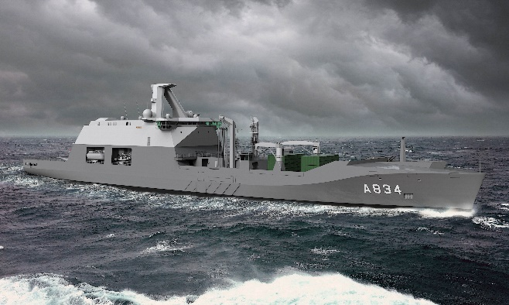
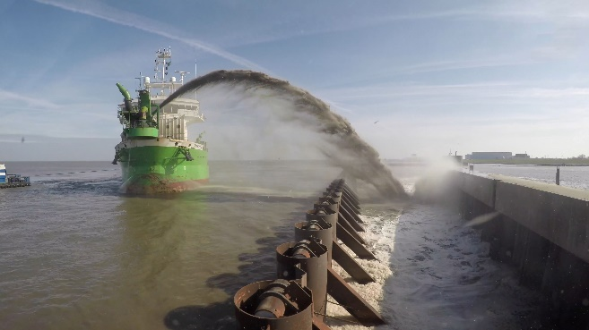
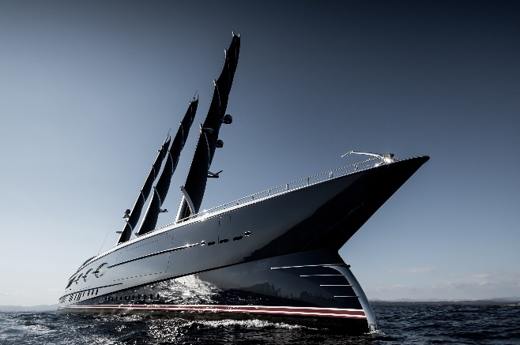
Alewijnse
All-round technological partner with over 130 years of experience in Marine and Industry
Working in 4 segments
Yachting
Dredging & Offshore
Navy & Governmental
Industry
New build, Refit, Solutions, Panel-building, Repair & Maintenance projects
International Footprint, own branches in the Netherlands, Romania, France and Vietnam
Competent & flexible
+/- 130 Engineers, +/- 600 Electrical Installers

Slide 3
Our History Over a Century of Experience
PRESENT
1889-1899
1900-1945
1945-1962
1962-1980
1980-2002
2002-2015
Start: Light bulb factory Roothaan, Alewijnse & Co
Electrical installation company C. Alewijnse & Co
Strong growth in electrical installations of factories and vessels
Start and take-over companies in Vlaardingen, Tiel, Drachten, Zwolle, Zaltbommel and Delft
Emergence of ICT, start-up company
in Romania, take-over company in Krimpen a/d IJssel
Internationalization and focus on engineering and automation
Take over by Strong Root Capital. Further focus on system integration

Slide 4
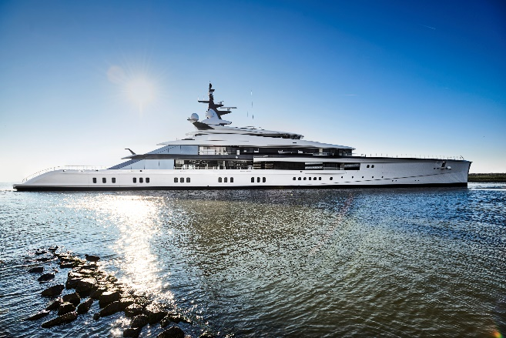
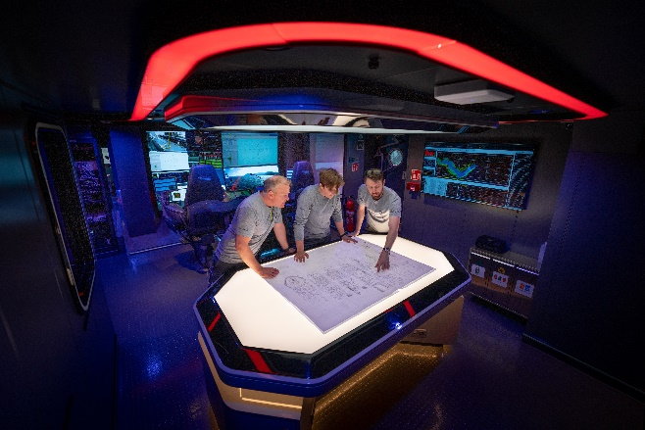
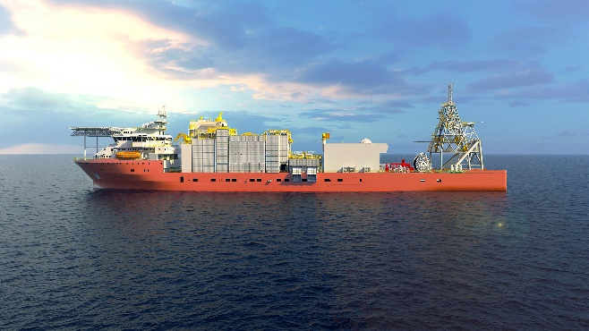
Our mission and vision
Mission
We Connect People and Technology
Vision
Our goal is to co-create value with and for our customers and partners. We aim to develop and improve electrification and automation solutions which are innovative, sustainable and of the highest quality. We focus on making a valuable contribution to successful projects in the Marine & Industry.

Slide 5
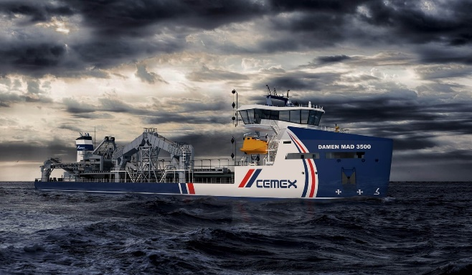
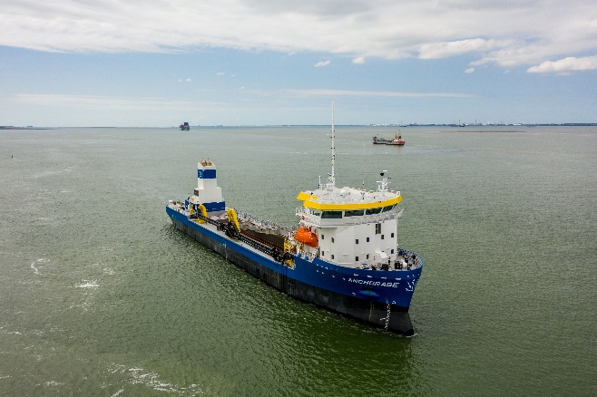
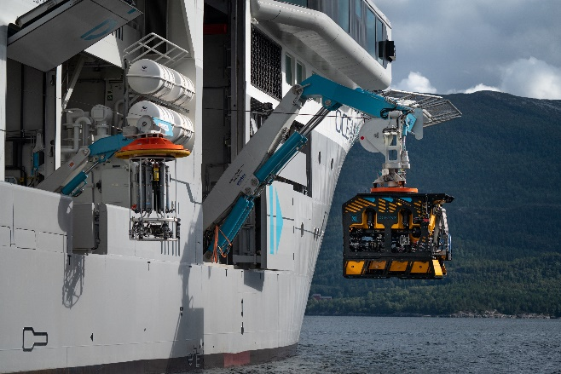
Our core values Incorporated in the way we work
Reliable
Involved
Transparent
Sustainable

Slide 6
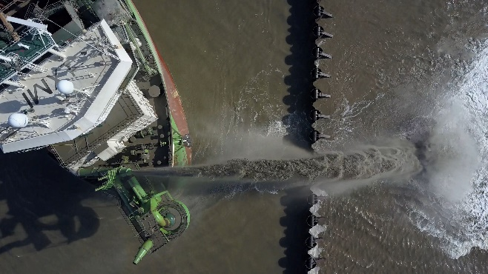
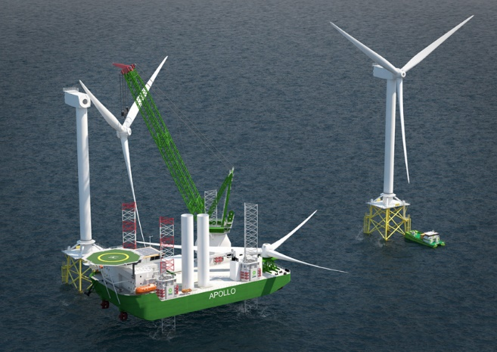
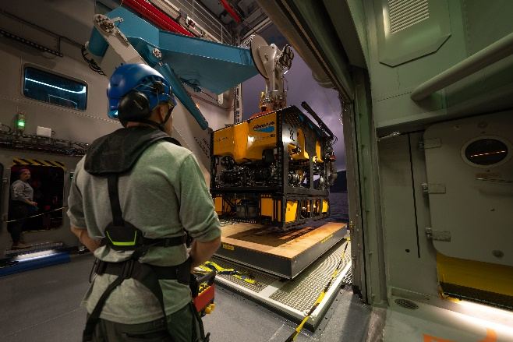
What we offer Our solutions
Vessel automation
Process automation
Navigation & Communication Systems
Electric Installation
Switchboards & Consoles
Power Distribution
Drive Systems
Hybrid Systems
Audio/Video & IT
Safety & Security

Slide 7
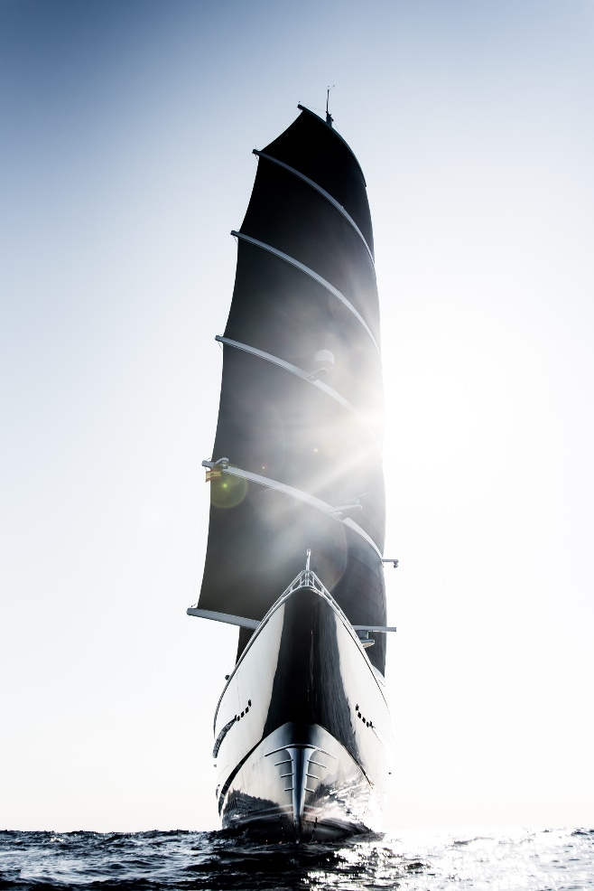
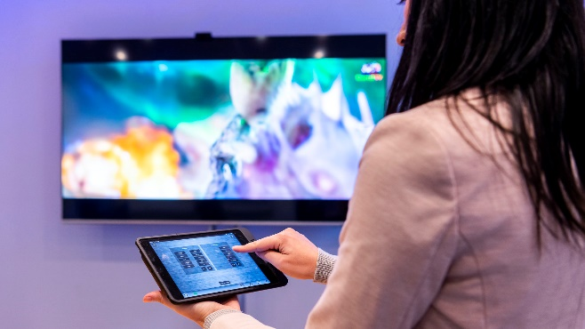
What we offer Our expertises
Your lifecycle partner in systems integration:
Newbuild
Refits & Modifications
Service & Maintenance
Spare Parts Delivery
Training

Slide 8
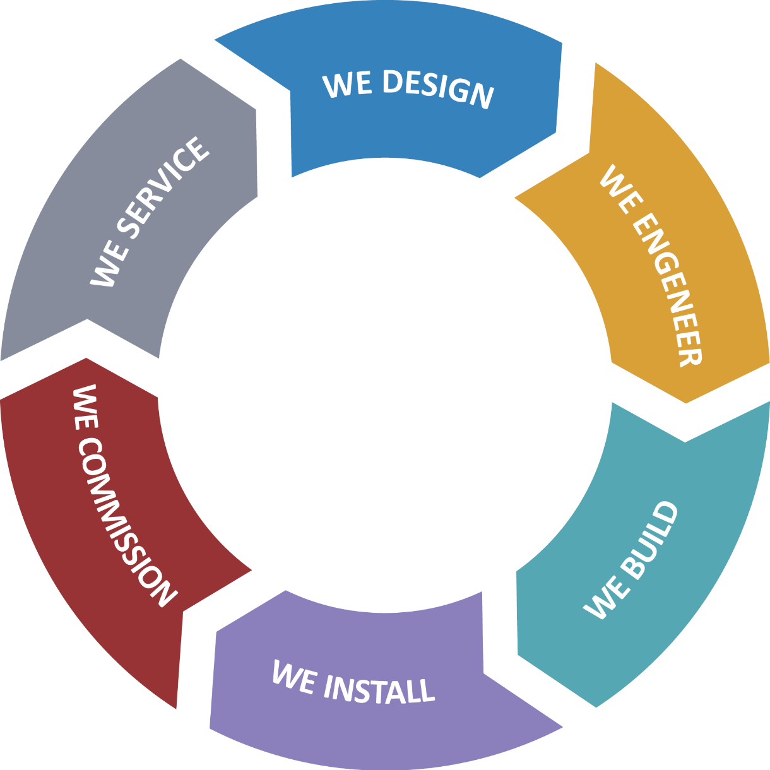
How we work During the entire lifecycle

Slide 9
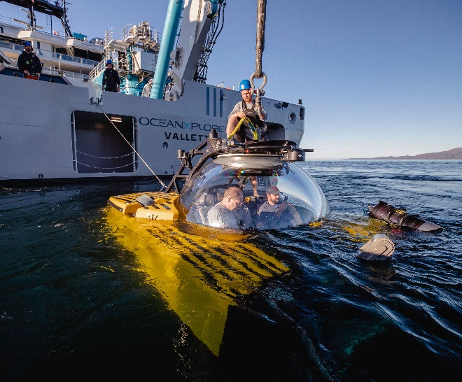
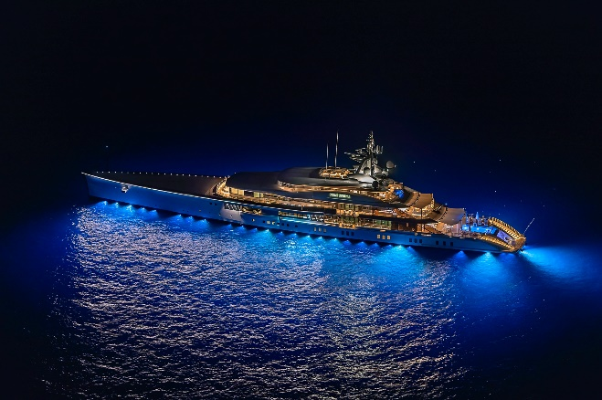
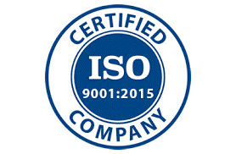
How we work Through the value chain
We work
Safe
Sustainable
Quality focused

Slide 10
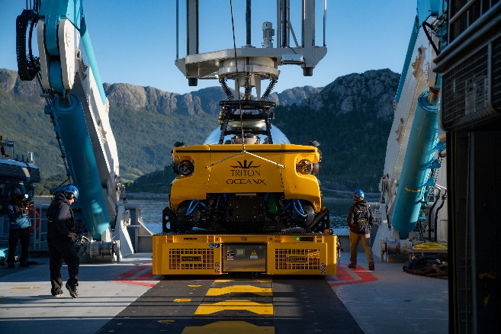
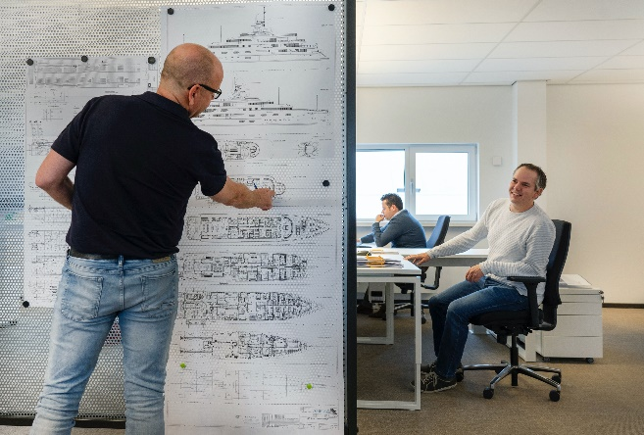
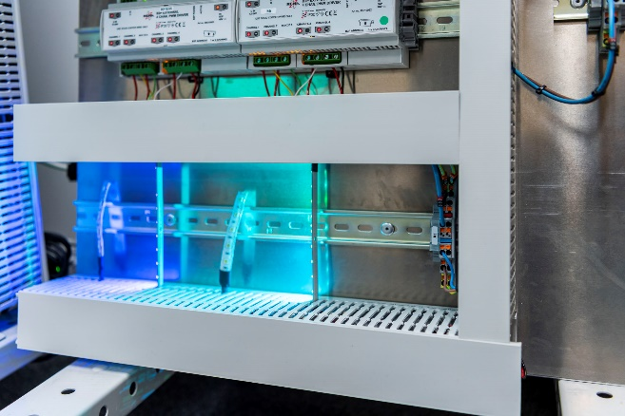
Why we are unique Global System Integrator with executing capacity
Our specific industrial & maritime system knowledge
Delivering high quality with attention to detail
Our engineering capacity
Our installing capacity
Project management capabilities: available as separate project components
Global availability
One stop shop
Inhouse switchboard production (Vietnam; Romania; Netherlands)
Refits & conversions knowledge
24/7 service & maintenance

Slide 11
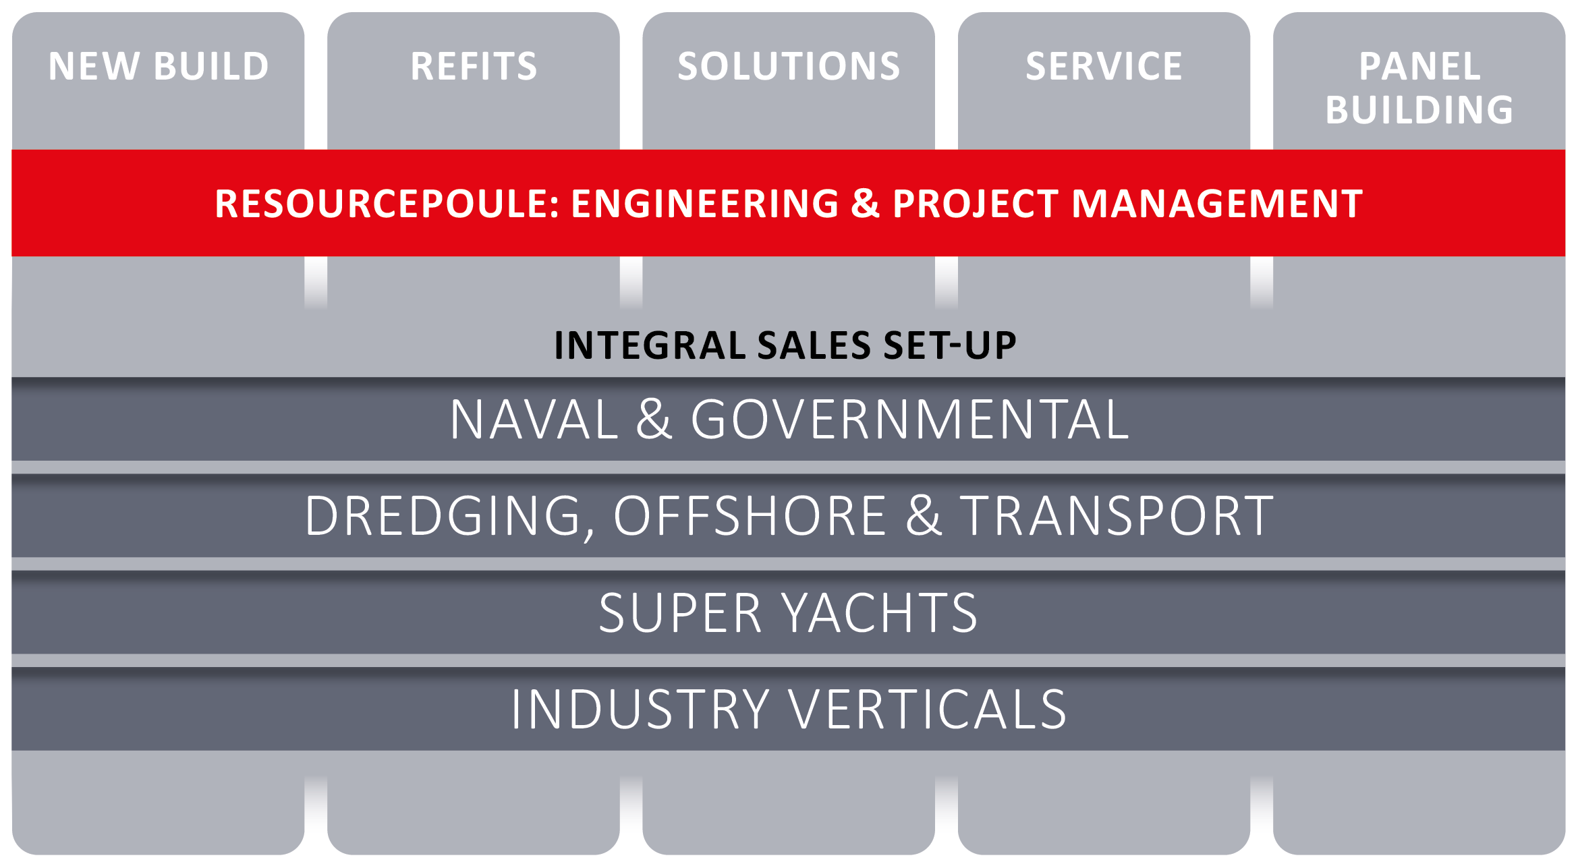
Alewijnse Groep

Slide 12
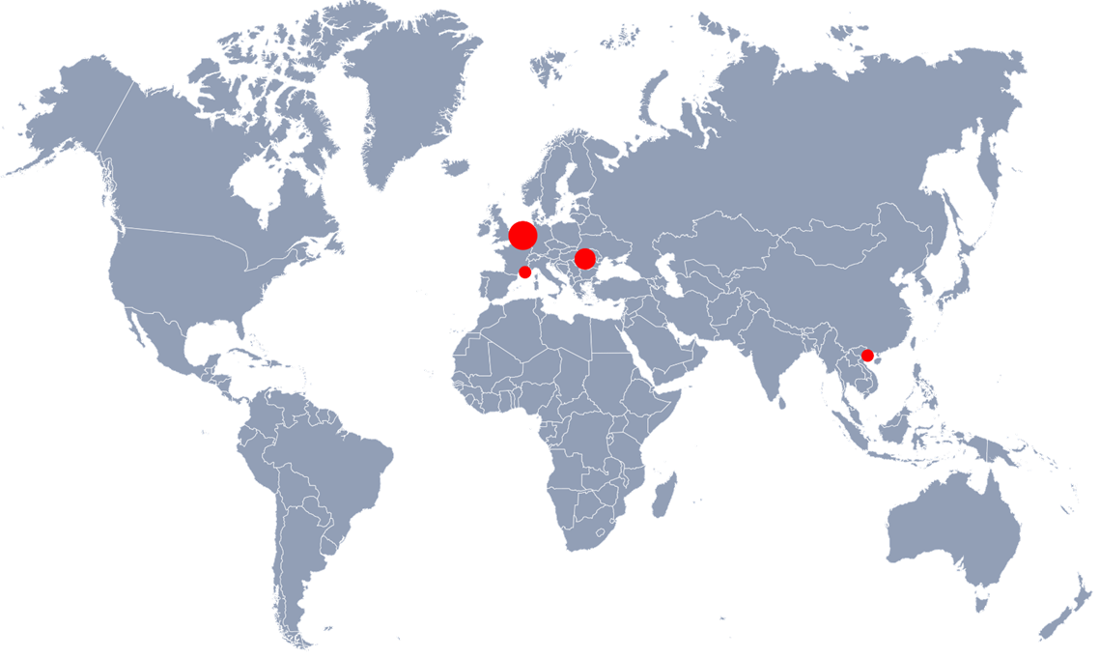
Our locations Where we work
The Netherlands Nijmegen (HQ), Rotterdam, Drachten
Romania Galati, Mangalia
France La Ciotat
Vietnam Hai Phong

Slide 13
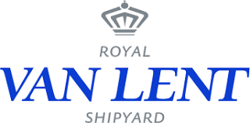
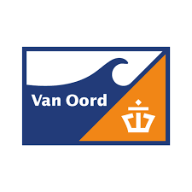
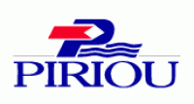
Our customers Whom we connect

Slide 14
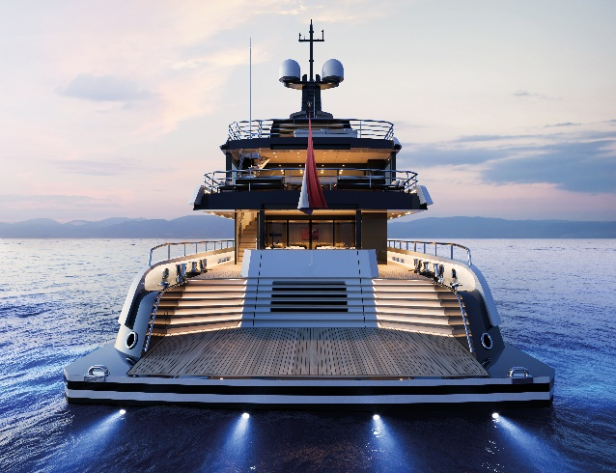
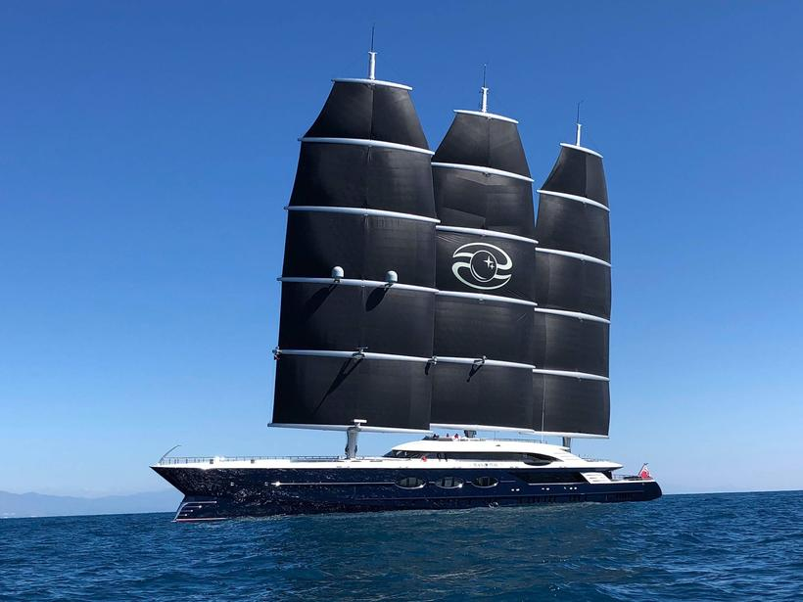
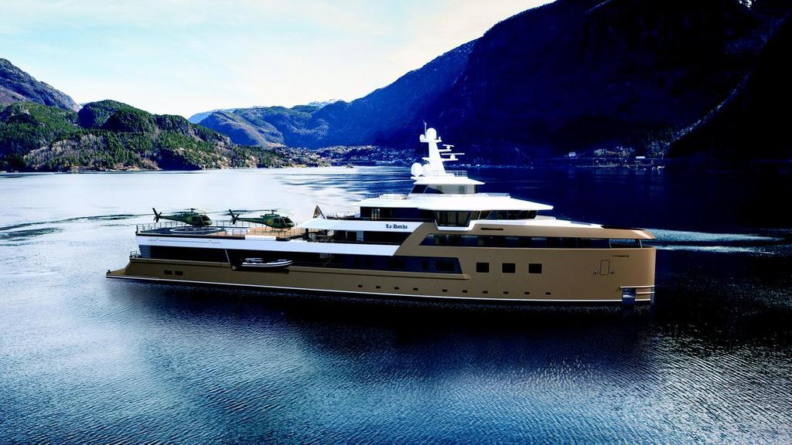
Yachting
Amels 60 series
Super Yacht (120m)
Newbuild: Complete electrical, Nav-Com and AV-IT systems installation
Black Pearl
Sailing Yacht (106m)
Newbuild: System Integration; Complete Electrical Installation
SeaXplorer La Datcha
Expedition Yacht (77m)
Newbuild: AVIT system; CCTV system

Slide 15
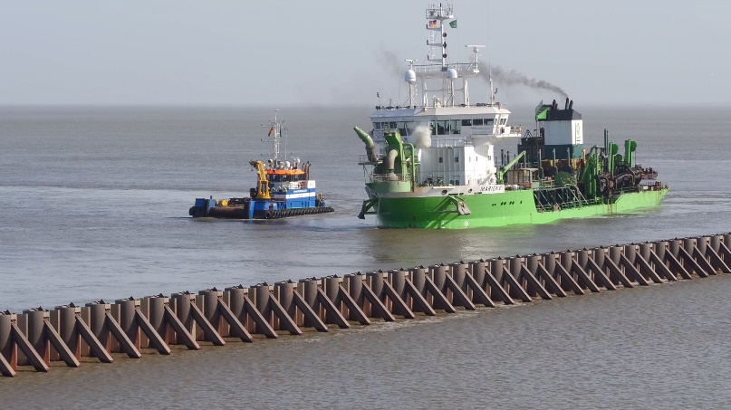
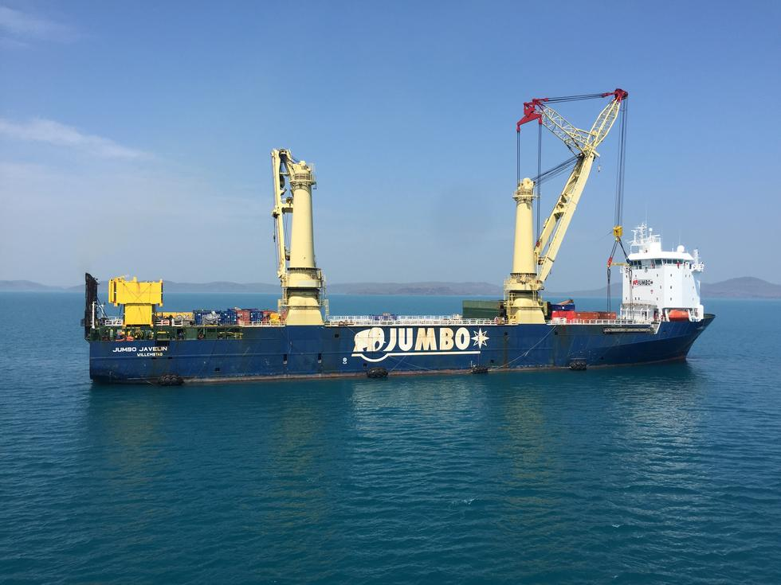
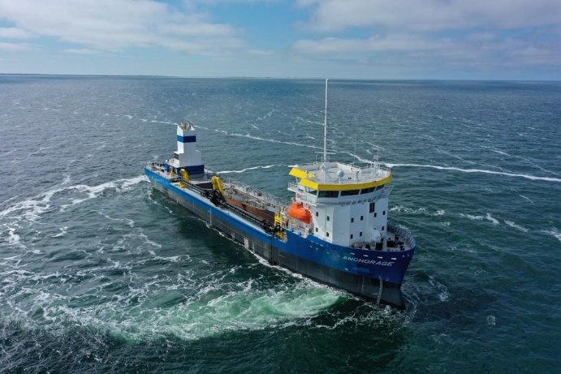
Dredging, Offshore & Transport
DEME TSHD’s
Refits: Automation systems, Dredge & Control System (DCS), Draught and Loading Systems (ADLS), Suction Tube Systems (ASTS)
Jumbo Javelin
Heavy Load & Crane vessel (144m)
Refit: Distribution panels; modifications to AMCS and PMS
Anchorage
Trailing Suction Hopper Dredger (3000m3)
Newbuild: Electrical Installation and Automation Systems

Slide 16
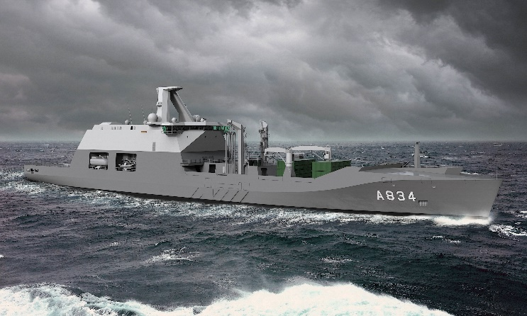
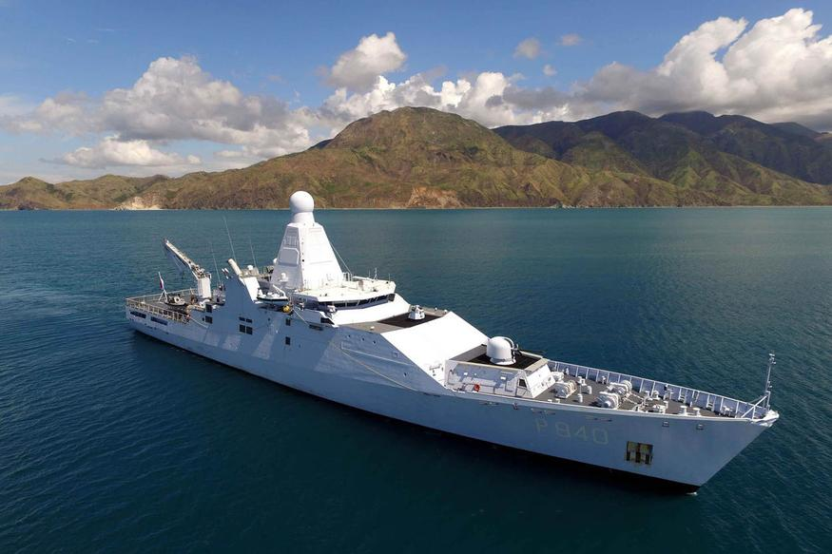
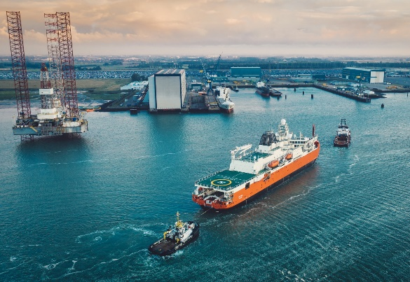
Naval & Governmental
Zr. Ms. Den Helder
Combat Support Ship (179,5 meter)
Newbuild: installation activities, including of the military equipment
Reformador
Long Rage Ocean Patrol Vessel (107,5m)
Newbuild: System Integration; Installing; Supervising; Commissioning on site
Nuyina
Antarctic Supply & Research vessel (160m)
Newbuild: System Integration; Complete Electrical Installation

Slide 17
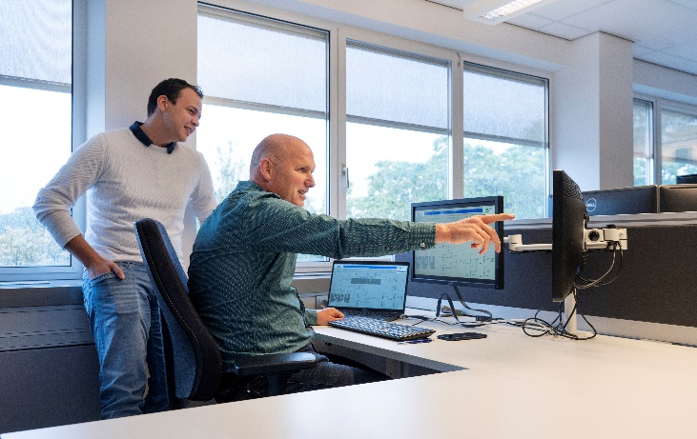
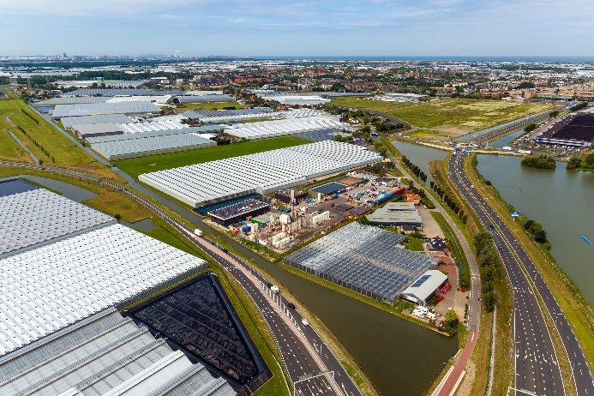
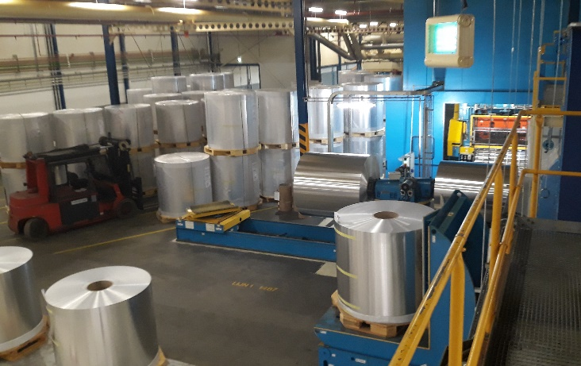
Industry
Food
T. Boer & Zn
New main distributor for extra cold storage
Geothermical energy
VB Geo Projects
Nine wells on production sites
Process and manufacturing
Ardagh Metal
Cabling for new production line

Slide 18
Why choose Alewijnse? Customer quotes
‘’The quality is outstanding’’
“Alewijnse works with you as a co-maker and partner.”
“The company has got in depth knowledge on multiple systems in many branches.”
“We are confident in their ability to meet challenges on complex, specialist vessels.”
“The company’s design and installation engineers form a valuable part of our yard team.”
“Our projects are completed thanks to excellent all-round cooperation and the total commitment.”
“Alewijnse shows that they are flexible and can handle a service job like this using local staff and their remote access capability.“

Slide 19
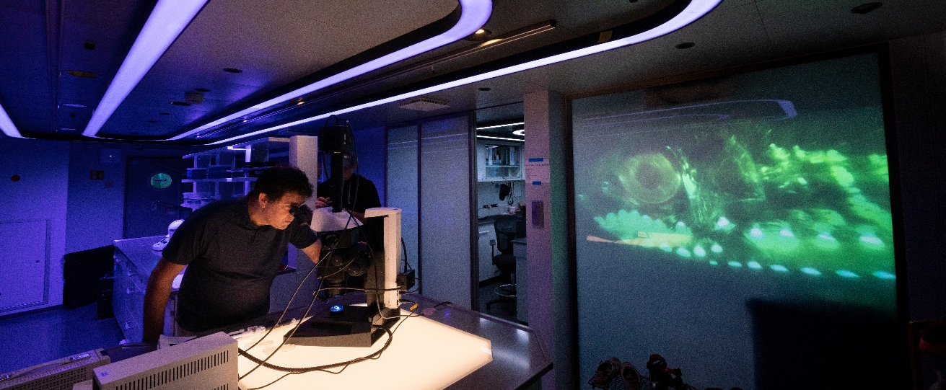
Ready for innovation?
Let’s Connect!
www.alewijnse.com
+31 (0)24 371 6100

